Slide 1

Analog And Digital Communication
Welcome

Slide 2
A.M & A.M DSB-SC Signals
Atul Anand
BETN1CS15028
CSE-A(2nd Yr.)
Bharti Parmar
BETN1CS15032
CSE-A(2nd Yr.)
Kamlesh Sharma
BETN1CS15048
CSE-A(2nd Yr.)

Slide 3

Outline
AM signal
Advantages/Disadvantages
DSB-SC signal
Demodulation(Envelope Detector)
Tuned Circuit & Waveform
Selection of RC time const.

Slide 4
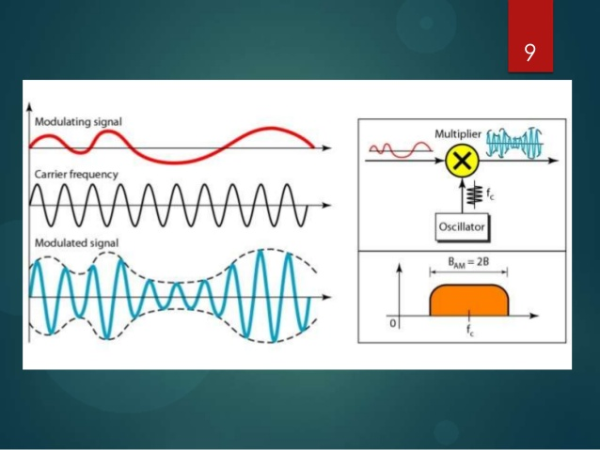
A.M Signal
AM signal is made up of a carrier (with constant frequency) in which its amplitude is changed (modulated) with respect to the signal (modulating signal) we wish to transmit (voice, music, data, binary).

Slide 5
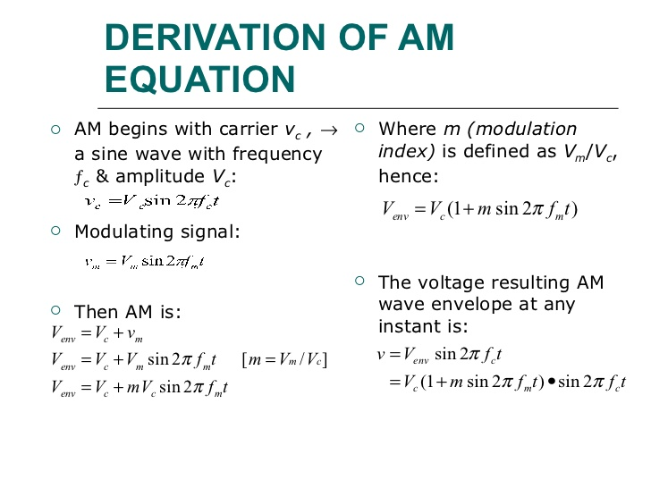

Slide 6
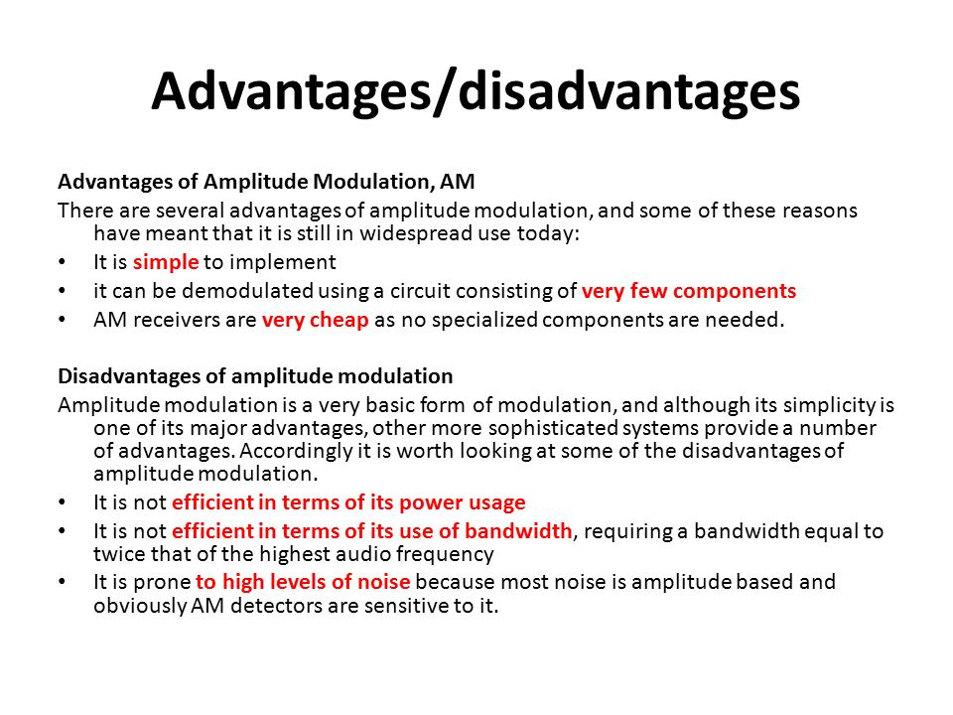

Slide 7
A.M DSB-SC Signal
DSB-SC (Double-sideband suppressed-carrier transmission) is a transmission in which the frequency produced by the amplitude modulation is distributed symmetrically across the carrier wave in order to decrease the power wastage or to increase the efficiency up to the 50% from the normal AM which is about 2/3rd of the whole i.e, 33.333%.
This transmission spaces the frequency above and below of the carrier wave symmetrically and the carrier level is reduced to the lowest practical level, ideally being completely suppressed.

Slide 8
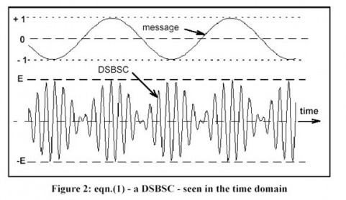
A.M DSB-SC (Contd.)

Slide 9
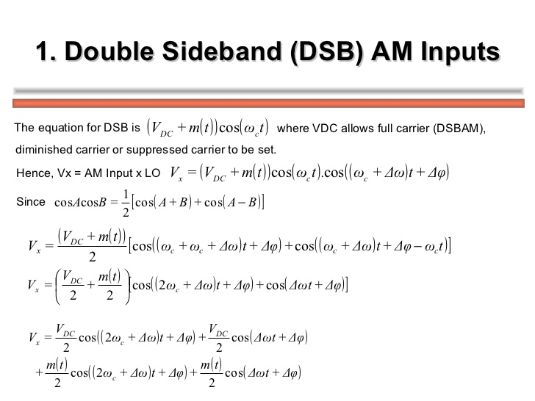

Slide 10
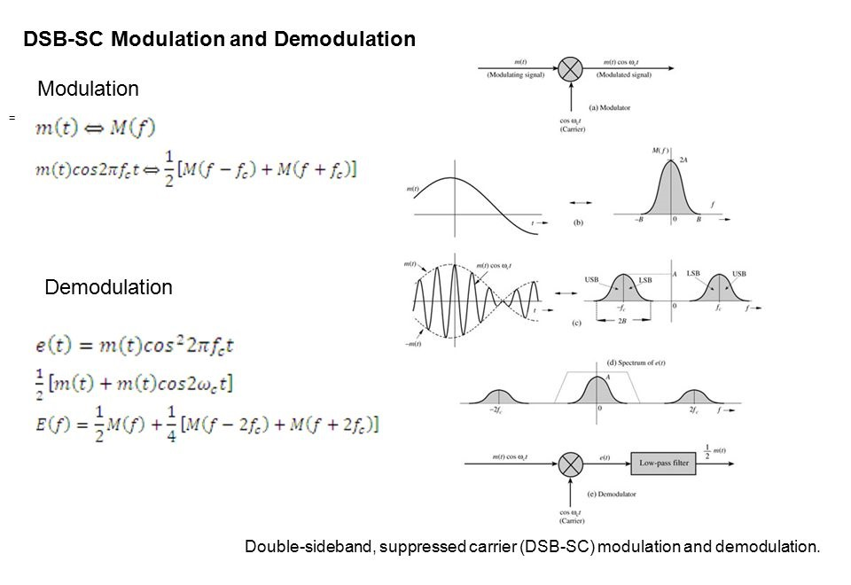

Slide 11
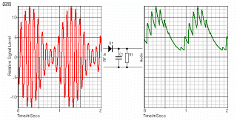
AM Demodulation(Envelope Detector)
The envelope demodulator is a simple and very efficient device which is suitable for the detection of a narrowband AM signal.
A narrowband AM wave is the one in which the carrier frequency f_{c} is much higher as compared to the bandwidth of the modulating signal .
An envelope demodulator produces an output signal that follows the envelope of the input AM signal exactly . It is used in all the commercial AM radio receivers .

Slide 12
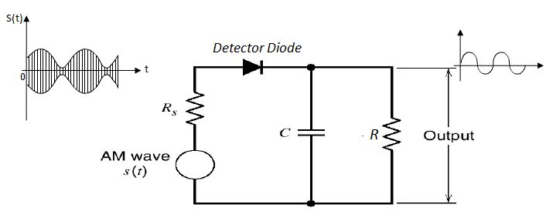
Circuit Diagram
The circuit diagram of the envelope demodulator is shown in figure.
The envelope demodulator consists of a diode and RC filter .

Slide 13
Working Operation
The standard AM wave is applied at the input of the demodulator .
In every positive half cycle of the input, the demodulator diode is forward biased and charge the filter capacitor C connected across the load resistance R to almost the peak value of the input voltage.
As soon as the capacitor charges to the peak value, the diode stop conducting .
The capacitor will now discharge through R between the positive peaks as shown in next figure . The discharging process continues until the next positive half cycle .
When the input signal becomes greater than the capacitor voltage, the diode conducts again and the process repeats itself .

Slide 14
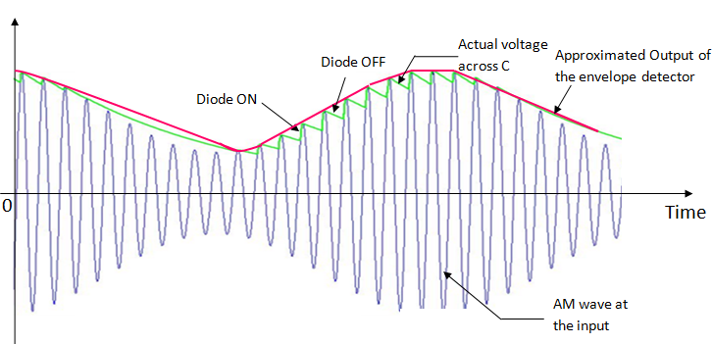
Waveforms
The input-output waveforms for the envelope demodulator is shown in figure.
It shows the charging discharging of the filter capacitor and the approximate output voltage .
It may be observed from these waveforms that the envelope of the AM wave is being recovered successfully .
Here we have assumed that the diode is ideal and the AM wave applied to the input of the demodulator is supplied by a source having internal resistance Rs .

Slide 15
Selection of the RC time Constants
The capacitor charges through D and Rs when the diode i on and it discharges through R when the diode is off.
The charging time constant RsC should be short compared to the carrier period 1/fc .
Thus,
RsC << 1/fc
On the other hand, the discharging time constant RC should be long enough so that the capacitor discharges slowly through the load resistance R . But, this time constant should not be too long which will not allow the capacitor voltage to discharge at the maximum rate of change of the envelope .
Therefore,
1/fc << RC << 1/fm
where, fm = Maximum modulating frequency

Slide 16


Kamlesh Sharma
BETN1CS15048
CSE-A(2nd Yr.)
Bharti Parmar
BETN1CS15032
CSE-A(2nd Yr.)
Atul Anand
BETN1CS15028
CSE-A(2nd Yr.)
Thank You

